Slide 1
Programming

Slide 2
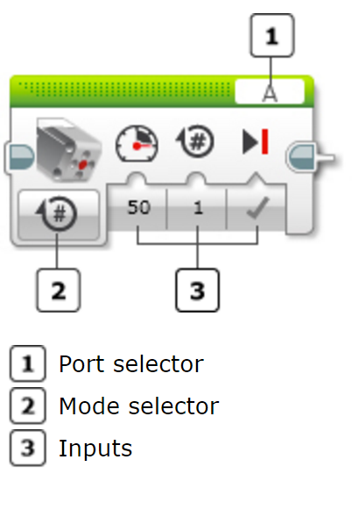
Action Block: Medium motor
The medium motor block controls a medium motor. You can turn the motor on or off, control its power level, or turn the motor on for a specified amount of time or rotations.
Notes:
The Medium Motor’s internal rotation sensor measures the degrees of rotation. When using On for Degrees, the block will wait until the motor has turned exactly the number of degrees specified before the program will continue to the next block. If the motor encounters resistance or a physical limit, and it is unable to complete the specified number of degrees, the block will continue waiting. No other blocks in the program will execute until the resistance is removed.
You can use the Off mode with Brake at End set to False to “release” a motor that is being held in a stopped position. This can, for example, allow you to adjust the motor’s position by hand in the middle of a program.

Slide 3
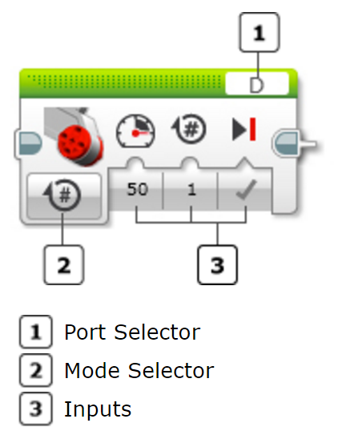
Action block: Large motor
The large motor block controls a large motor.
You can turn a motor on or off, control its power level, or turn the motor on for a specific amount of time or rotation.
Notes:
You can use the Off mode with Brake at End set to False to “release” a motor that is being held in a stopped position. This can, for example, allow you to adjust the motor’s position by hand in the middle of a program.

Slide 4
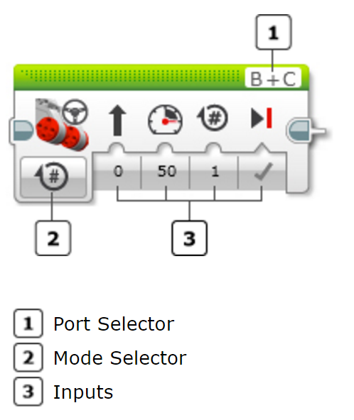
Action block: Move steering
The move steering block is used to control a robot with two large motors; one of the left and one of the right.
It drives the robot forward and backward, turns, and stops.
The move steering block will control both motors at the same time, to drive your vehicle in the direction that you choose.
Notes:
On for Degrees: turns both motors on, waits until one of them has turned for the number of degrees of rotation in the Degrees input, and then turns both motors off. This can be used to make your robot travel a specific distance or turn a specific amount. 360 degrees of rotation corresponds to one full turn of a motor.
On for Seconds turns both motors on for the number of seconds in the Seconds input, then turns them off. The block will wait until the time has passed before the program will continue to the next block.
On for Rotations turns both motors on, waits until one of them has turned for the number of rotations in the Rotations input, then turns both motors off. This can be used to make your robot travel a specific distance or turn a specific amount.
The Power Left and Power Right inputs accept a number from -100 to 100. Positive and negative numbers make the Large Motor turn in different directions (forward and backward).
Make sure that with your robot facing “forward”, the motor on the left side is the first one listed in the Port Selector. Otherwise, your robot will turn in the wrong direction.

Slide 5
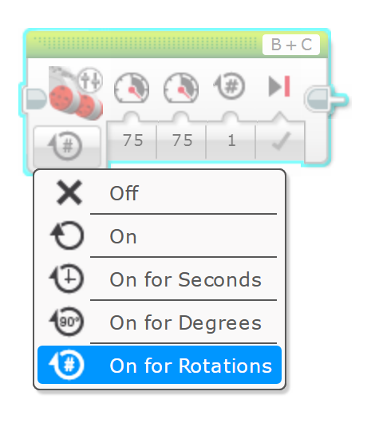
Action block: Move tank
The move tank block is used to control a robot with two large motors; one of the left and one of the right.
It drives the robot forward and backward, turns, and stops.
The move tank block make the two motors go at different speeds or in different directions to make your robot turn.
Notes:
On for Degrees: turns both motors on, waits until one of them has turned for the number of degrees of rotation in the Degrees input, and then turns both motors off. This can be used to make your robot travel a specific distance or turn a specific amount. 360 degrees of rotation corresponds to one full turn of a motor.
On for Seconds turns both motors on for the number of seconds in the Seconds input, then turns them off. The block will wait until the time has passed before the program will continue to the next block.
On for Rotations turns both motors on, waits until one of them has turned for the number of rotations in the Rotations input, then turns both motors off. This can be used to make your robot travel a specific distance or turn a specific amount.
The Power Left and Power Right inputs accept a number from -100 to 100. Positive and negative numbers make the Large Motor turn in different directions (forward and backward).
Make sure that with your robot facing “forward”, the motor on the left side is the first one listed in the Port Selector. Otherwise, your robot will turn in the wrong direction.

Slide 6
Steering and turning
What is the difference between the Move Steering Block and the Move Tank Block?

Slide 7

Flow block: start
The Start Block marks the beginning of a programming block sequence in your program. Your program can have more than one sequence.
If a sequence of programming blocks does not start with a Start Block, the blocks will not run.

Slide 8
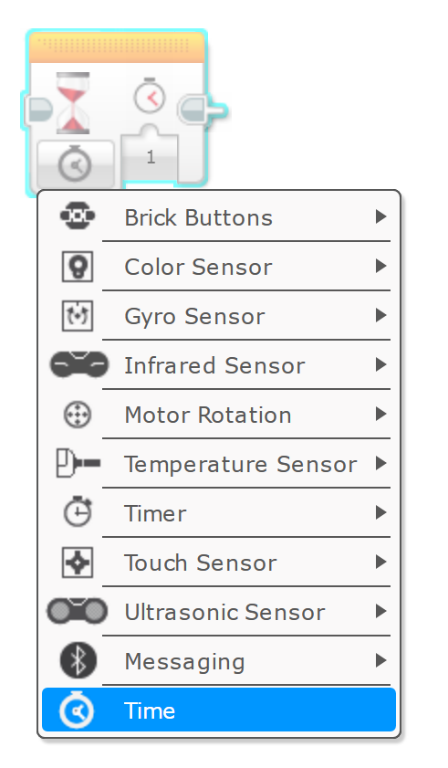
Flow block: Wait
The Wait Block makes your program wait for something before continuing to the next block in the sequence.
You can wait for a certain amount of time, for a sensor to reach a certain value, or for a sensor value to change.
The Wait block does not make your robot stop. If any motors are on at the beginning of the block, they will stay on during the wait.

Slide 9
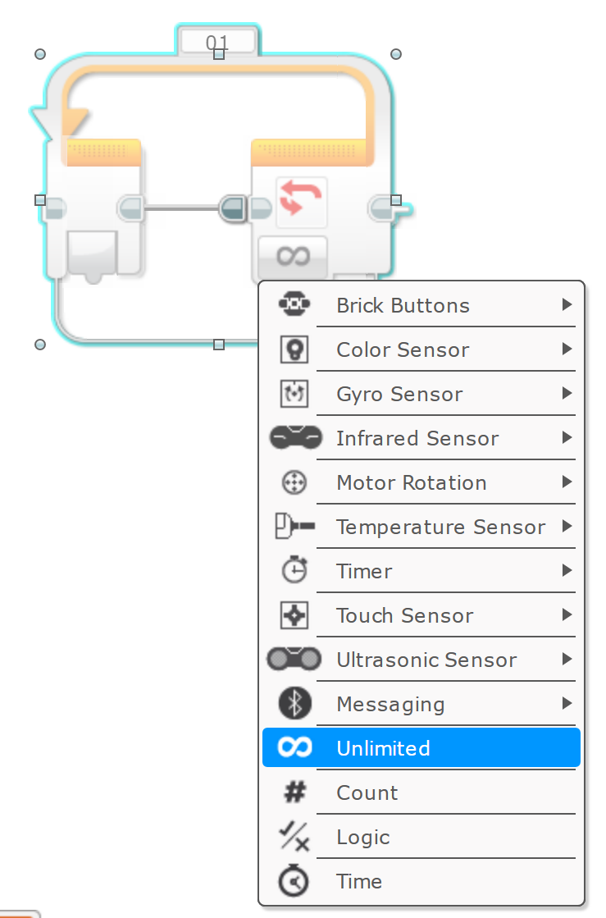
Flow block: Loop
The Loop block is a container that can hold a sequence of programming blocks.
It will make the sequence of blocks inside it repeat.
You can choose to repeat the blocks forever, a certain number of times, or until a sensor test or other condition is True.

Slide 10
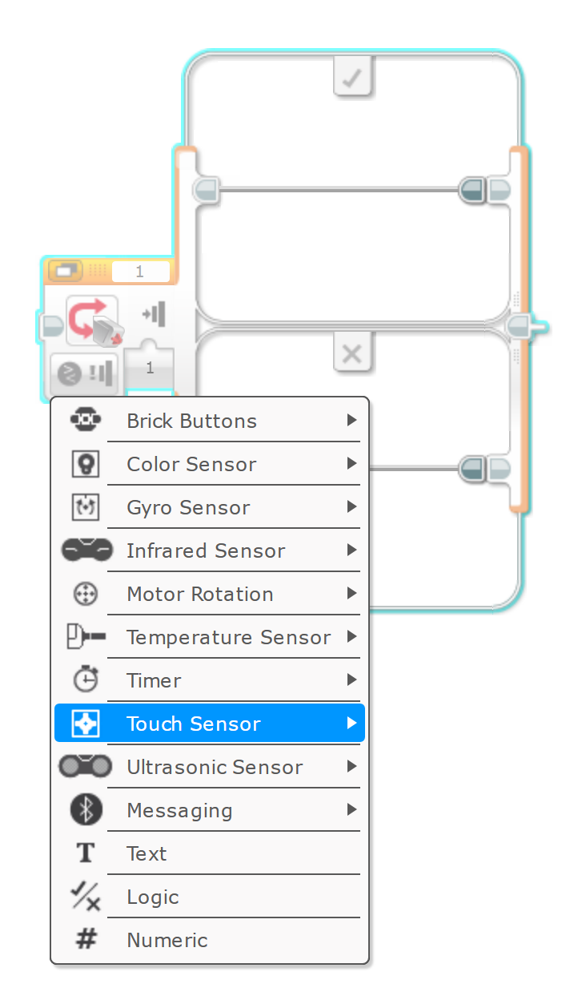
Flow block: Switch
The Switch block is a container than can contain two or more sequences of programming blocks. Each sequence is called a Case.
A test at the beginning of the Switch determines which Case will run.
Only one Case will run each time the Switch is executed.
Notes:
A Switch does not wait for a sensor data value or data wire to reach a certain value. The test is run as soon as the Switch block starts, and one of the Cases is chosen and run immediately after the test.
In the program above, you can press the Touch Sensor before the test (or even before the program starts) and hold it in during the test, to make sure the Switch executes the True Case. Try seeing how long you can wait before pressing the sensor and still have the robot say “Yes”.
You can leave any Case in a Switch blank if you don’t want the robot to do anything in that situation. Try removing the two blocks from the False Case in the program above and see what happens.

Slide 11
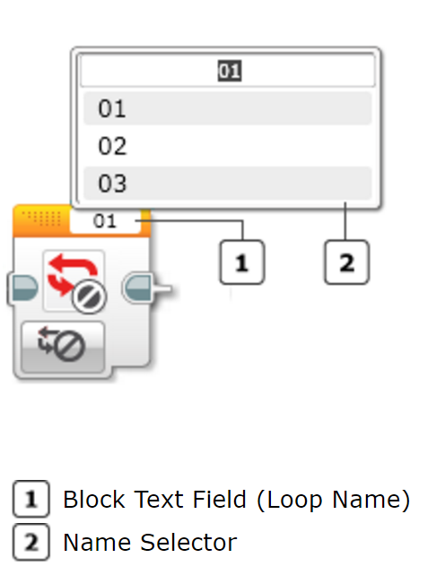
Flow block: Loop interrupt
The Loop Interrupt block makes a Loop block end.
No more blocks in the loop sequence will execute, and the program will continue with any blocks that are after the loop.
Notes:
You can specify which Loop block to interrupt by using its Loop Name.
You can use the Loop Interrupt block to make a loop exit sooner than it normally would, or in response to a different condition. You can interrupt a loop from inside the loop itself, or from another block sequence that is running at the same time.

Slide 12
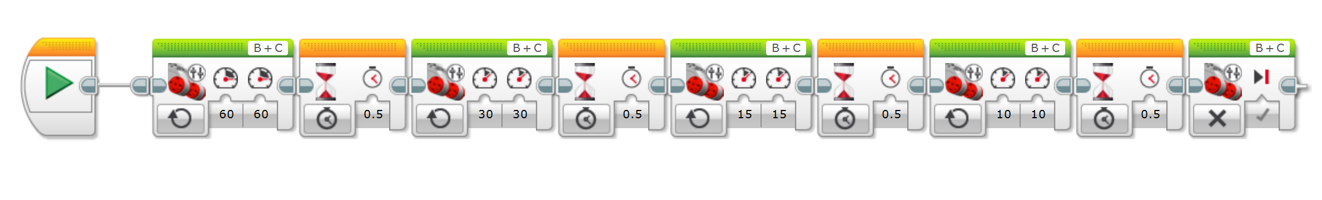
Describe what the robot is doing in this program

Slide 13
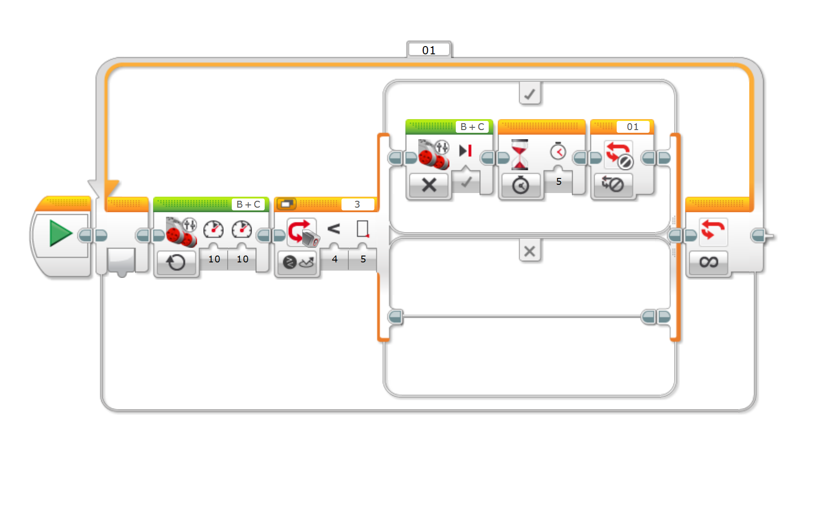
Describe what the robot is doing in this program

Slide 14
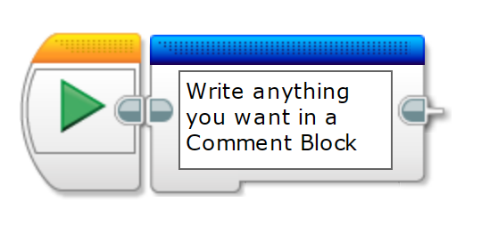
Advanced block: Comment
The comment block allows you to write comments within a program.
It is often used to provide an explanation of the subsequent blocks and expected actions.

Slide 15
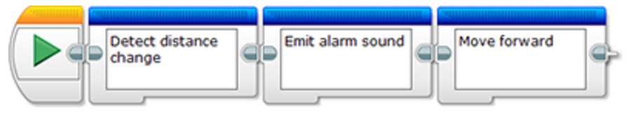
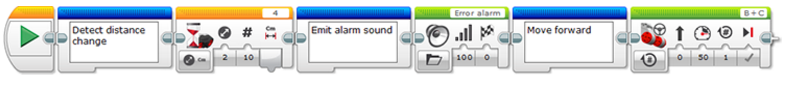
Pseudo code - coding in comments
Use a different Comment Block to describe each step in the program you are planning to make.
Once you have described all the steps (also called an algorithm) in plain language, you can insert the programming blocks after each comment block describing the step.

